Slide 1
FRICTION SPINNING

Slide 2
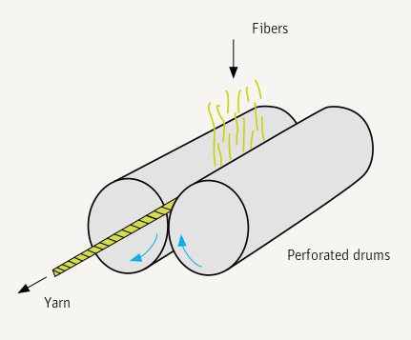
Friction Spinning Principle

Slide 3
The operations to be carried out in this spinning process
Opening of the fiber strand;
Acceleration of the fibers;
Collecting the fibers into a new strand;
Imparting strength by twisting;
Withdrawal of the resulting yarn;
Winding onto a cross-wound package.

Slide 4
Classification
Feed :
Single-sliver feed;
Multiple-sliver feed (Dref-2000 and Dref-3000);
Opening assembly :
One opening assembly;
Two opening assemblies or drafting devices (Dref-3000);
Separation of collecting and twisting functions :
collection and friction assemblies separated;
friction assembly also serves as collecting device;
Contd…

Slide 5
Classification
Number of friction surfaces :
One friction surface (Dref-1);
Two friction surfaces;
Type of friction assembly :
Perforated drums;
One perforated drum with one smooth drum (blind drum);
Two discs;
Disc and roller in combination;
Two crossed belts.

Slide 6
The most widely used types are those with the following characteristics:
Single-sliver feed;
One opening roller;
Friction assembly also acting as collection device;
Two friction surfaces;
Two perforated drums or one perforated drum and one blind drum in combination.

Slide 7
Technological Relationships
Feed
Opening
Fibre transport
Fibre collection
Imparting twist
Withdrawal and winding up

Slide 8
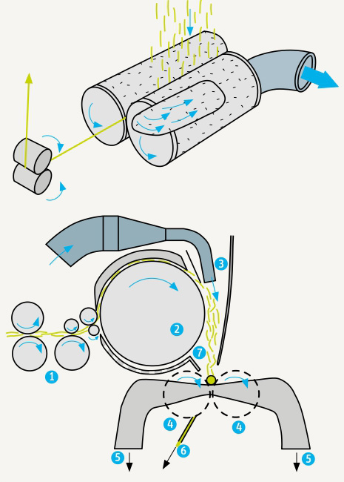
DREF - 2
Feeding Zone
Opening Roller
Blower
Perforated Drum
Suction Stream
Friction Yarn
Open Fibres

Slide 9
Specification of Dref-2
Spinning positions per machine | 6 - 64
Delivery speed | 250 m/min
Raw material | wool, bast fibers, synthetic fibers, secondary fibers
Count range | Ne 0.3 - 14.5; 2 000 - 40 tex
Feedstock | card sliver
Yarn packages | up to 8 kg
Yarn type | normal OE yarn
Yarn characteristics | woolen-spun character, round, even

Slide 10
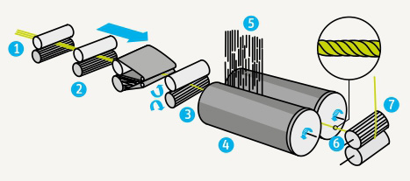
DREF – 3
1. Draw frame Sliver 2. Drafting arrangement
3. Fibre Strand 4. Spinning Drums
5. Open Fibres 6. DREF – 3 Yarn
7. Take off Rollers

Slide 11
Specification of Dref-3
Spinning positions per machine | 3 - 24
Delivery speed | 250 m/min
Raw material | cotton/synthetic fibers
Count range | Ne 0.3 - 14.5; 2 000 – 40 to 700 tex
Feed stock | draw frame sliver
Type of Yarn | bundled yarn
Yarn characteristics | few envelope fibers = ring-spun yarn character; many envelope fibers = rotor-spun yarn character

Slide 12
Advantages of DREF – 3 Yarns
Dref-3 is a typical process for the production of yarn specialties:
Yarns made from unusual fibers;
Composite yarns with a special core/sheath structure;
Yarns with special properties (protective textiles).
Suitable for producing special tailor made yarns.

Slide 13
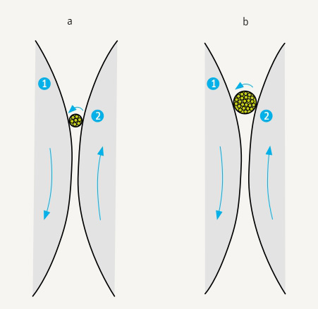
Fine and coarse yarns in the convergent region of friction-spinning drums

Slide 14
Advantages of Friction Yarns
Advantages are as follows :
High delivery speeds;
Low yarn production costs (lower than those of ring spinning);
Elimination of rewinding;
Low end breakage rates;
Yarn character similar to that of ring-spun yarn;
No wrapping fibers;
Optically good mass evenness (well suited to knitted goods);
Better and softer handle than that of rotor-spun yarn;
Smooth yarn appearance.

Slide 15
Disadvantages of Friction Yarns
Disadvantages are as follows :
Low yarn strength;
High tendency to snarl;
Higher number of fibers needed in yarn cross-section;
Difficulty of keeping spinning conditions constant;
High air consumption;
Increasing unevenness and imperfections with increasing spinning speed, and further reduction in yarn strength.

Slide 16
Limitations of Friction Spun Yarns
Low yarn strength.
The extremely poor fibre orientation renders the friction spun yarn very weak.
Twist variation from surface to core is quite high. (another reason for poor strength)
Requirement of higher no. of fibres (100-150) in yarn x-see, limit the fineness of yarns.
Yarns have higher snarling tendency.
Increase of yarn unevenness & imperfection as production speed increases.
High consumption of air.

Slide 17
Fibre specifications for optimum results in Friction Spinning
The fibre specifications, for optimum results in order of preference are :
Fibre to fibre & fibre to metal friction
Fibre tenacity
Fineness
Length
Cleanliness.
Contd…

Slide 18
Fibre specifications for optimum results in Friction Spinning
i. Fibre to fibre & fibre to metal friction -
The twisting rate in friction spinning is largely dependent on friction between fibres & drum surface. Therefore, a higher coefficient of friction between fibre and metal is desirable. A higher inter-fibre friction is also desirable for proper binding of fibres in core as well as the sheeth.
Contd…

Slide 19
--- Fibre specifications for optimum results in Friction Spinning
ii. Fibre Tenacity -
The inherent low strength of friction yarn can be partly overcome through use of high tenacity fibres. So high tenacity fibres are recommended for friction spinning.
Contd…

Slide 20
--- Fibre specifications for optimum results in Friction Spinning
iii. Fineness -
Finer fibres help in increasing friction surface & meeting the requirement of greater no. of fibres in yarn cross section. (100-150) fibres
Contd…

Slide 21
--- Fibre specifications for optimum results in Friction Spinning
iv. Fibre Length -
The fibre length requirement in friction spinning is similar to that in rotor spinning with optimum lying between 32-38 mm. Longer fibres are more susceptible to damage & lapping around the opening roller and acquire more disorientation while landing on the spinning down causing loss in strength.
Contd…

Slide 22
--- Fibre specifications for optimum results in Friction Spinning
v. Cleanliness –
A cleaner feed would help in preventing frequent clogging of perforations in the spinning drums.
Contd…

Slide 23
End Uses : Friction Spinning
Weft & pile yarns
Velvets
Blankets
Terry towels
Knit-goods
Furnishings
Filters
Technical fabrics
Secondary carpet
Backings of polypropylene
Low cost interlinings
Spun yarns for industrial textiles
Conveyer belts
Tarpaulins roof coverings

Slide 24
Yarn Quality of Friction Yarn
In general the friction yarn is 30-40% weaker than ring yarn due to poor fibre orientation, twist differences from out side to inside and unidirectional migration (out side to inside). The strength deficit increases as one moves to longer fibres as they suffer greater damage during opening and acquire more disorientation while landing on the spinning drum. The optimum fibre length for DREF 2 and sheeth of DREF 3 is 32-38 m.
Mass irregularity & imperfections in friction yarn are higher than ring yarns in 65/35 PC blend. But 100% cotton yarns are more regular than corresponding ring yarns but less regular than rotor yarn.
Contd…

Slide 25
--- Yarn Quality of Friction Yarn
These yarns have better appearance than ring & rotor yarns. However, the friction yarns are more hairy. These yarns show a lower abrasion resistance for cotton & blend yarns. These yarns are bulkier than ring yarns as it is spun at very low tension, 20% of that in ring spinning.
Spinning performance of 100% cotton yarn is better with 70% core & 30% sheeth than 50% core & 50% sheeth in DREF 3 but the yarn strength is better with the latter proportion.
There is significant mass variation due to periodic air stream caused by spiral clothing of
Contd…

Slide 26
--- Yarn Quality of Friction Yarn
Opening roller. This results in periodic strength variation. Also, due to poor control on twist insertion rate there is variation from one spinning position to the other.
Friction yarn has a soft hand. The yarn spinning process does not encounter many breaks due to very low spinning tension. Most of the weak places are passed on to winding.
The yarn quality deteriorates and end breaks go up as one tries to spin finer counts as the sleave suffers from discontinuities or holes having very few fibres.
Contd…

Slide 27
--- Yarn Quality of Friction Yarn
This result is increased chances of a break in contact the yarn tail & the sleave the minimum no. of fibres required in the cross-section to form yarn is of a higher order in friction spinning than even in rotor spinning.

Slide 28
Friction Yarn Quality Comparison with Ring Yarn
Sl. No. | Property | Comparison with Ring Yarn
1. | Strength | 30-40% weaker (Poor orientation twist difference.
2. | Mass irregularity & imperfections | Higher for 65/35 Pc blend.
3. | Appearance | Better
4. | Hairiness | More
5. | Abrasion resistance | Lower
6. | Bulkiness | More (low tension in spinning zone)
Contd…

Slide 29
Friction Yarn Quality Comparison with Ring Yarn
Sl. No. | Property | Comparison with Ring Yarn
7. | Mass variation | More (periodic air stream by spiral clothing opening roller)
8. | Strength variation | More (periodic air stream by spiral clothing opening roller) (poor control on twist insertion)
9. | Hand | Softer
10. | Spinning breaks | Lower (low tension) 20% less than Ring Spinning
11. | No. of fibres in yarn x-section | Higher than rotor yarn

